Slide 1
HSE ISF
ERS proposal
ERS
8 April 2014

Slide 3
Introduction
National ISF Core Objective “A Standards BasedFramework which will ensure key systems and components, can share data in timely and organised fashion.”
Key Strategic Objectives;
Cost Avoidance
Greater Efficiency
Better Control
3rd party delivery of systems
To facilitate the development of Electronic Health Records (EHR)
To enable horizontal data integration and overcome data silos
To facilitate a more controlled development environment
Greater re-usability of key components

Slide 5
Approach
Approach based on 12 Workstreams
Suppliers Framework for provision of specialist services
LOT: 4 Tender for HSE National Information Architecture Model
Award made to ERS B.V. in the Netherlands
LOT: Now at final draft stage

Slide 6
Introduction & (Simplified) Overview
Simplified overview of the model and key components
Understanding the recommendations
Making it real and deployable in simple terms
Next stage ‘quick win’ options
Simple deployment scenarios
Costs and Benefits

Slide 7

HSE ISF
IA-RM and SAM
ERS advocates a dual model approach
as determined by the consultation and Proof-of-Concept initiatives
  (1) Information Architecture Reference Model
    IA-RM as the basis for deployment in Ireland
  (2) Subject Area Models
    SAM’s as the expression of consensus data sets needed for Healthcare Providers to collaborate in clinical pathways
© ERS 2014

Slide 8
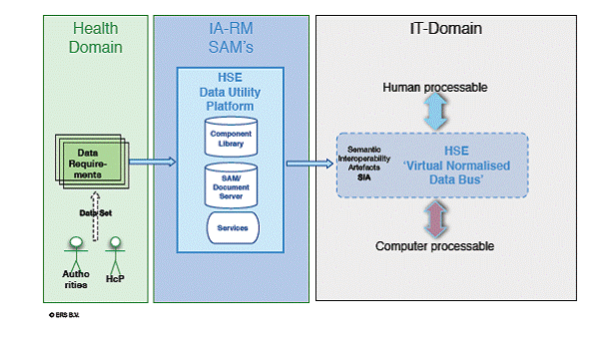
HSE ISF
IA-RM and SAM
Data requirements are transposed to a data set (eg from a clinical programme)
This Data Set is then transposed to a Subject Area Model available to all ICT systems
All SAMs are part of the IA-RM
A series of tools and services (the HSE Data Utility Platform) is needed to generate SAM’s
and their outputs (Semantic Interoperability Artefacts)
are needed by all actors (Health- and IT-Domains).
When deployed via Procurement
a ‘Virtual Normalised Data Bus’ will create a level green playing field for all,
based on open International standards

Slide 9
Information Architecture
Reference Model
ERS
6 April 2014

Slide 10
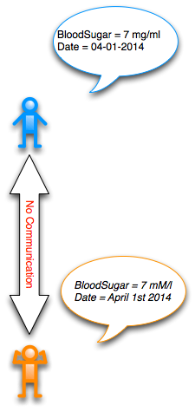
IA-RM
Why is an Information Architecture necessary?
  Both collaborating actors need to ‘understand’ each other
  Humans know how to bridge the gap; Computers do not
  Machine exchange of data needs very detailed and precise
  uniform agreements between IT-systems

Slide 11
What is the IA-RM
The IA-RM is a Standards based eHealth information model which defines the representation of the concepts, relationships, constraints, rules, and interactions for the HSE’s eHealth data. It also provides the means to actively control and manage these elements across a multitude of national systems.
When applied. it enables multiple parties to exchange management information about their data sets and their managed data elements. It provides an assured, organised, stable and sharable structure of information data for national clincal programmes and records including the enablement of a national EHR.

Slide 12
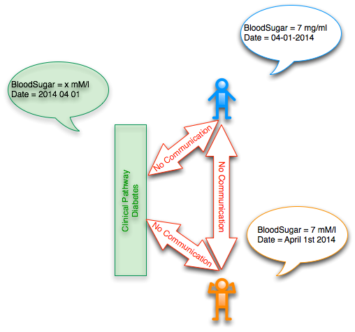
IA-RM
IA-RM
  The Information Architecture Reference Model (IA-RM)describes how collaborating actors and their IT-systems must exchange data
  Actors need to adapt to all the standards defined in the IA-RM

Slide 13
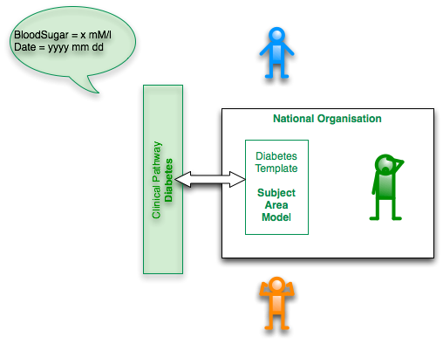
IA-RM
National Organisation
  One National Organisation must be responsible for the IA-RM and
  its collection of Subject Area Models (SAM’s)
  SAM’s contain the details that the IT-systems of Actors must adopt

Slide 14
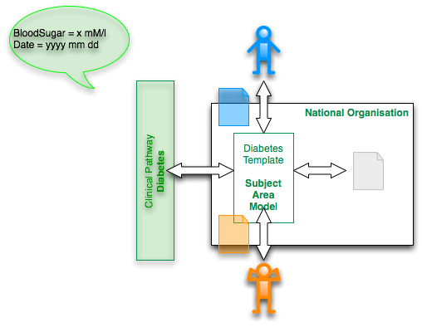
IA-RM
SAM and outputs
  The SAM’s are used to generate outputs
  that are readable by Humans
  Validation of the SAM’s by Actors is essential
  The technical artefacts are generated, also,
  and help IT-vendors to deploy the SAM’s uniformly

Slide 15
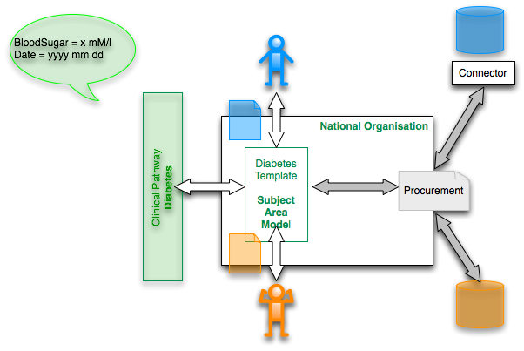
IA-RM
Deployment via procurement
  Procurement is the most efficient way to deploy the IA-RM and SAM’s
  Either existing IT-Systems use the SAM’s (and outputs)
  to create Connectors
  in order to be able to claim compliance with the standards
  or create new IT-systems that can claim compliance with the standards

Slide 16
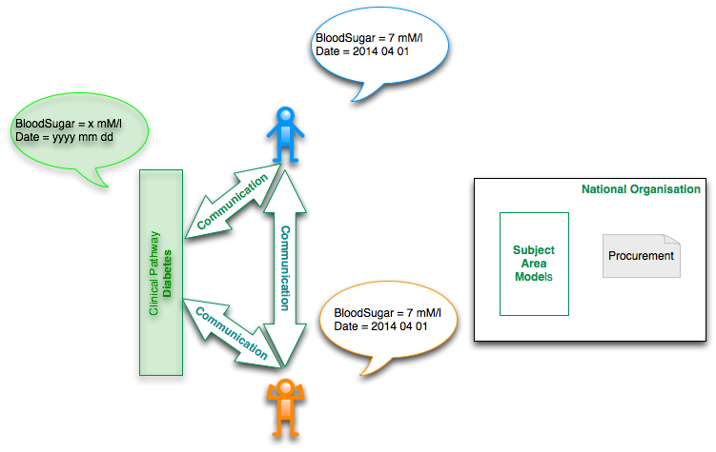
IA-RM
Deployment in healthcare
  Healthcare Actors, using compliant systems,
  can exchange agreed health data
  Their IT-systems are semantically interoperable

Slide 17
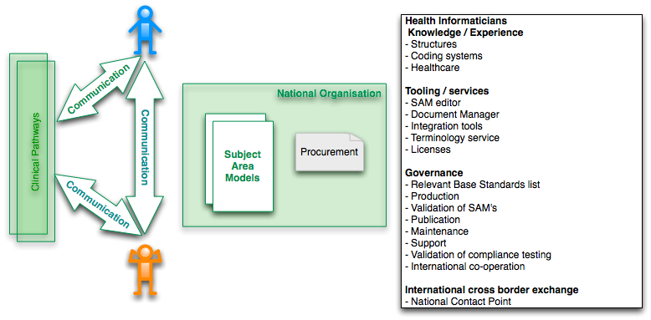
IA-RM
The National Organisation has well defined responsibilities
The new eHealth organisation will also need the IA-RM to carry out it function

Slide 18
Subject Area Models
From Clinical Pathways to Collaboration
ERS
  6 April 2014

Slide 19
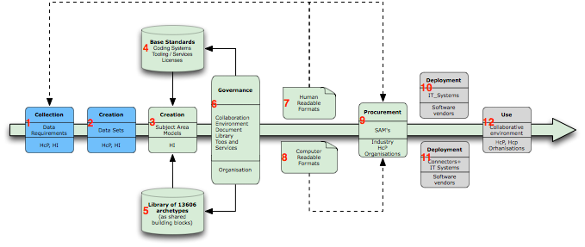
Subject Area Models from Clinical Pathways to Collaboration

Slide 20
Subject Area Models
1 - Data requirements
  When Healthcare Providers co-operate they need to agree on the data requirements
  Health Informaticians support Healthcare Providers with the data gathering.
  Healthcare Proffesional Organisations will play a role

Slide 21
Subject Area Models
2 - Data Set
  After consensus the Data Set is created based on the acquired data requirements
  Healthcare Providers and their Organisations
  are facilitated by the Health Informatician
  Many are already available to a significant degree

Slide 22
Subject Area Models
3 - SAM
  Health Informaticians define the Subject Area Models (SAM’S)
  These are CEN ISO 13606 Templates,
  built using CEN ISO 13606 Archetypes
  The SAM’s express more details than ISO 11179 Data Dictionaries allow

Slide 23
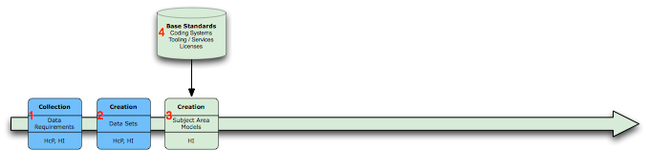
Subject Area Models
4 - RESOURCES
  SAM’s are based on the CEN ISO EHR Communication Standard
  and many supporting relevant adopted standards
  including licensed Coding Systems such as: SNOMED-CT. ICD-x, LOINC, etc.
  Technically the SAM’s are CEN ISO 13606 Templates

Slide 24
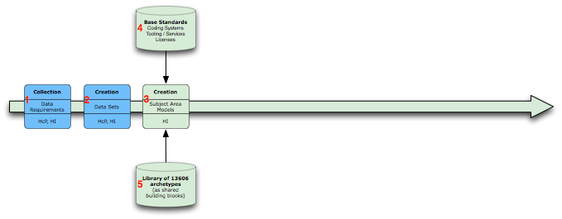
Subject Area Models
5 - Library of Archetypes as building blocks
  SAM’s (13606 Templates) are build using predefined archetypes
  as shared building blocks
  SAM’s will carry relevant codes from the Coding Systems selected
  SAM’s represent fully the content of Data Sets

Slide 25
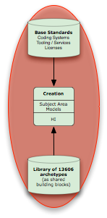
SAM construction
a
d
epSOS Data Set
CEN GPICS
(CIMI)
b
c
Subject Area Models
Subject Area Models are En13606 Templates
created with an Archetype Editor
Templates are build using a Library of Archetypes
Library of Archetypes consists of shared patterns/clinical models (e.g. ‘Demographics’, ‘Lab test’, ‘Diagnosis’, ‘Complaint’, etc.)
Many Data Sets and Archetypes exist already
(epSOS data set, GPICS, eventually CIMI project)

Slide 26
SAM construction
SNOMED-CT
LOINC
ICD-x
‘Dugs database’
b
a
a
Subject Area Models and Codes
Archetypes and Templates carry codes
supplied by a Terminology Server
SNOMED-CT, LOINC, ICD-x, ‘Drugs database’
(using licenses)

Slide 27
SAM construction
a, b, c
Tooling
Archetype Editor to build Templates and Archetypes, and define data elements, attach codes
Document Management System to manage documents / files: Archetypes and Templates, to manage the building blocks plus all other associated materials (guides, etc.)
Terminology Server to populate the SAM’s, Templates, Archetypes with codes

Slide 28
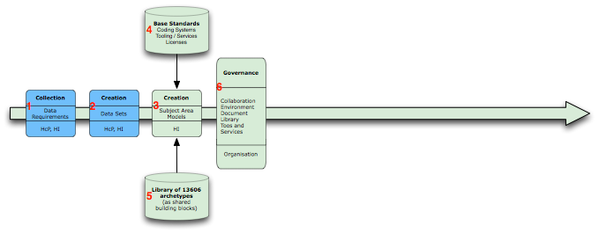
Subject Area Models
6 - Governance
  An Organisation will govern the process, the tools, services, archetype-, and code set-repositories.
  Observe that one of the services must be a Testing/Validation service to evaluate IT-systems that claim compliance with the published SAM’s.

Slide 29
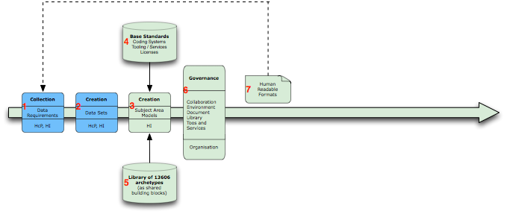
Subject Area Models
7 - Validation: SAM human readable output
  The SAM editor tool produces human readable output (Spreadsheet, graphs, etc.)
  This output is used by the Health Informatician and the Healthcare Providers and their organisations for the validation of the SAM’s produced
  All SAM’s an their output will have to be managed in A Document Management System

Slide 30
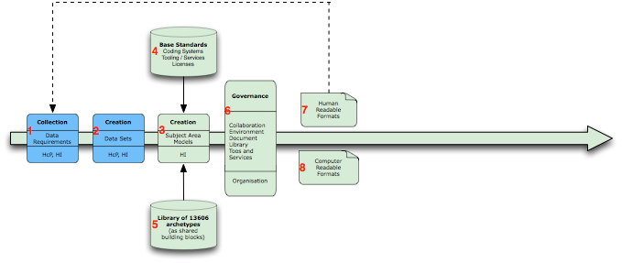
Subject Area Models
8 - SAM computer procesable output
  Next to human readable output computer processable documents are produced that support the IT-industry with the deployment.
  All SAM’s an their output will have to be managed
  in a Document Management System

Slide 31
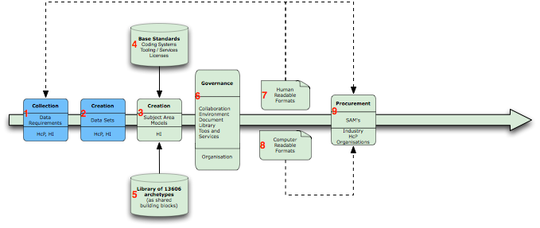
Subject Area Models
9- Procurement
  All published and validated SAM’s and their outputs can play a role in the procurement process for new IT-systems or exchange capabilities.

Slide 32
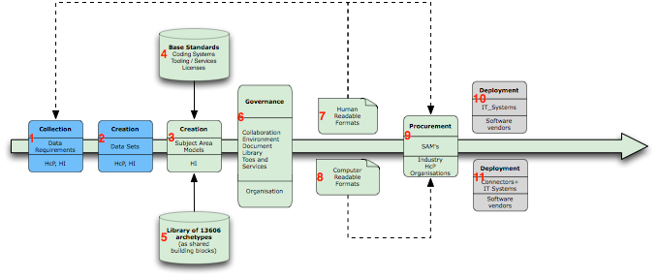
Subject Area Models
10/11 - Deployment
  The SAM’s provide the maximally detailed requirements as expressed by the Healthcare Providers and their organisations based on open International standards
  The IT-industry can use these SAM’s to build new systems
  Or exchange solutions (EHR-Extracts, HL7v2, HL7v3 CDA, …)

Slide 33
Subject Area Models
12- Collaborating Healthcare Providers
  IT-systems that deploy the SAM’s need to be tested
  Before these systems are allowed to support collaborating Healthcare Providers

